Slide 1

Engitech Services LLC
Driven by Latest Technologies
Technology Stack
Products
Introduction
Development Services
Core Competencies
Some of Our Projects
Some Success Stories
www.engitechservices.com

Slide 2


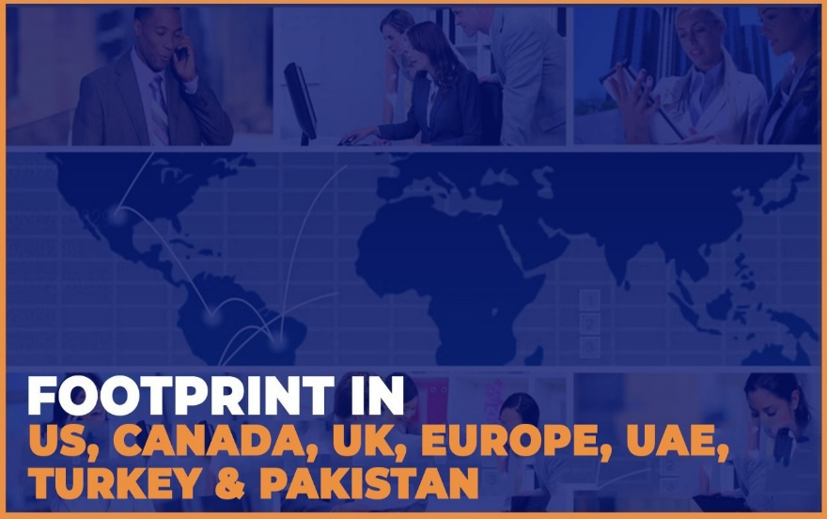

Technology Stack
Products
Development Services
Core Competencies
Some of Our Projects
Introduction
Some Success Stories
Intro

Slide 3



Technology Stack
Products
Development Services
Core Competencies
Some of Our Projects
Intro
Some Success Stories
Introduction
Competency

Slide 4
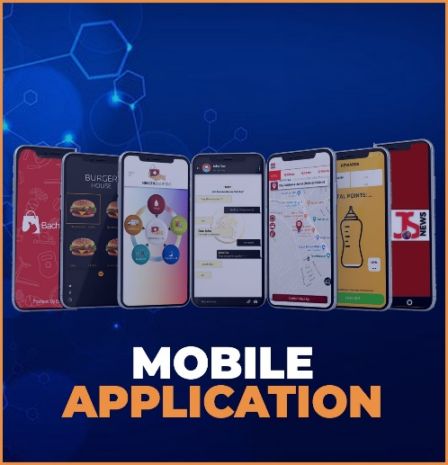




1
2
Mobile Application
Custom Software
Technology Stack
Development Services
Products
Core Competencies
Some of Our Projects
Some Success Stories
Introduction
Dev. Services
Intro
Competency
3
4
Managed Services
Web Development

Slide 5









Technology Stack
Development Services
Products
Some of Our Projects
Core Competencies
Dev. Services
Some Success Stories
Introduction
Competency
Products
Intro

Slide 6
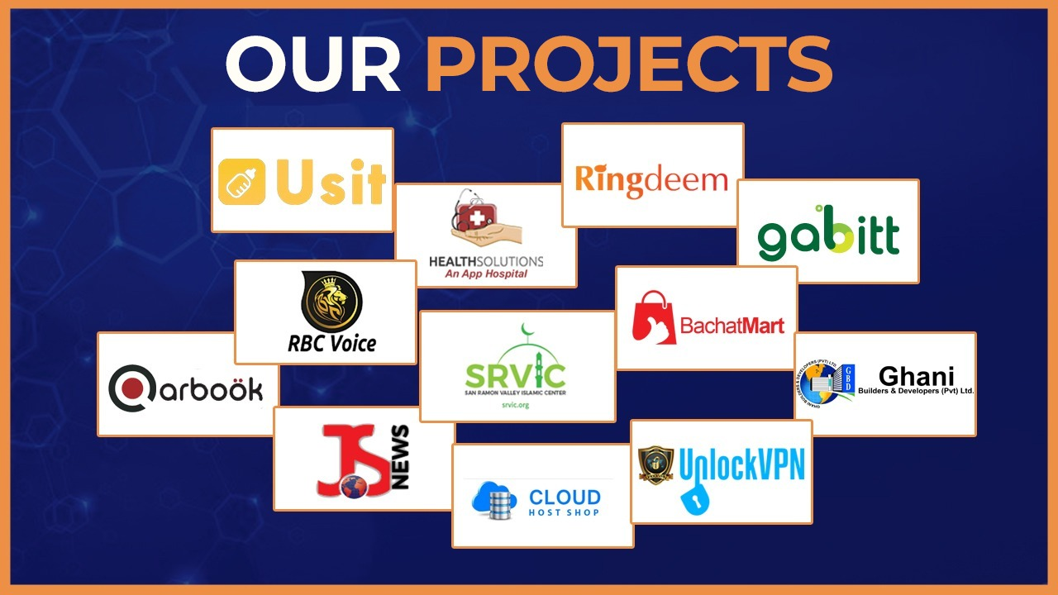
Technology Stack
Products
Development Services
Core Competencies
Some Success Stories
Some of Our Projects
Dev. Services
Introduction
Customers
Products
Competency
Intro

Slide 7








Usit is a baby sitter App of USA connects households to college students, creating more opportunities for students and more possibilities for parents. We developed and maintain Android App, iOS App, DevOps
RBC Voice is a business community project of Turkey having Mobile Apps. We create the WhatsApp replica in order to meet the customer requirement We developed and maintain: Android App, iOS App, DevOps
HealthSolutions is a platform to provide Healthcare services having Ambulance, Blood, Chemist, Diagnostics, Equipment, Fitness, Tele Consultancy & Home Care. Engitech owns this project as a SaaS having Website, Android App iOS App
Travelofa is a travelling website of United Kingdom. On that website you will find all the best reviews and information about travel and adventure.
We developed and maintain:
Website, DevOps
Technology Stack
Products
Development Services
Core Competencies
Some of Our Projects
Dev. Services
Some Success Stories
Introduction
Customers
Products
Competency
Intro
Qarboök is cab service project of UK and Europe having mobile Apps like Uber. We developed and maintain: Android Passenger App Android Driver App, iOS Passenger App, iOS Driver App, Control Panel
San Ramon Valley Islamic Center is a non profit organization that offers a broad range of religious, educational. cultural, social and charitable activities in USA. We developed and maintain: Website, DevOps
Booho is an online shopping store (e-commerce) of United Kingdom.
We developed and maintain:
Website
DevOps
Gabitt is cab service project of Pakistan having mobile Apps like Uber. We developed and maintain: Android Passenger App, Android Driver App, iOS Passenger App, iOS Driver App, Control Panel

Slide 8
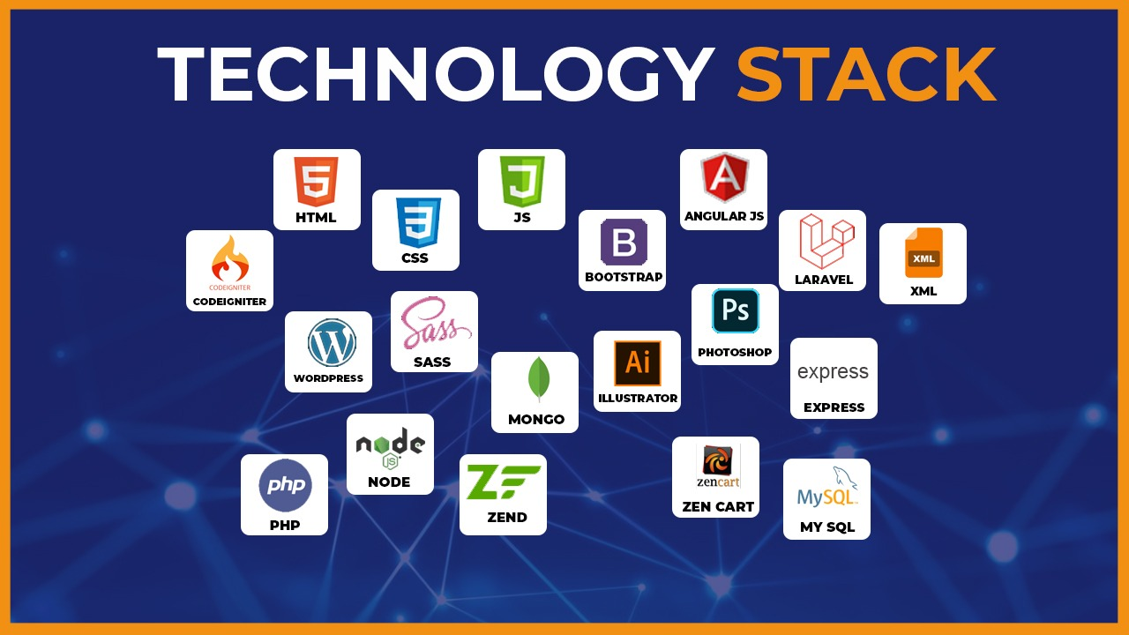
Products
Technology Stack
Products
Core Competencies
Development Services
Success Stories
Some of Our Projects
Introduction
Dev. Services
More Happy Customers
Customers
Products
Competency
Intro

Slide 9


Thanks
Technology Stack
Products
Development Services
Core Competencies
Some of Our Projects
More Happy Customers
Introduction
Engitech Services LLC
Canada / Pakistan / US / UAE
info@engitechservices.com

